Slide 1

STUDENT AI NAVI HELPER

Slide 2

DESCRIPTION
An artificial intelligence (AI)-driven software program called a voice assistant is made to understand and respond to spoken orders and questions from people. It uses a combination of technologies such as speech recognition, natural language processing (NLP), and machine learning to understand spoken language and provide relevant and contextual responses. Voice assistants are typically integrated into devices, applications, or platforms, allowing users to interact with technology.
The rapid growth in advancing technological landscape, the integration of virtual assistant technology has transcended its initial applications, extending its reach into the physical realm of college campuses. Virtual Assistant for College Navigation represents an innovative fusion of artificial intelligence (AI), mobile technology, and contextual awareness, aimed at revolutionizing the way individuals traverse and interact with their academic landscapes.

Slide 3
Team Members
TEAM NO:VH211
Students Name | mailid
D.Sai Dattu | 9921004180@klu.ac.in
T.Prem Subhash Manideep | 99210042229@klu.ac.in
M.Kavya Sri | 99210041354@klu.ac.in
K.Hari Krishna | 99210042174@klu.ac.in

Slide 4
Table of contents
01
02
03
04
05
06
Introduction
Results
Proposed System
Future Works
Implementation
References

Slide 5



Slide 6
Benefits
The Voice Assistant can be used by the new students coming to
college and also used by the existing students to find a place.
It will also pop up the image of the destination place where the user can go.
The Voice Assistant can be used for the students in a way to
find the particular areas in college premises.
Another functionality of the Voice Assistant is that the result for the user Query will be in different form like in text format, Speech format.

Slide 7

System Steps
Data Collection and Preparation
Develop Speech Recognition
Implement Natural Language Understanding
Design User Interface
Implement Response Generation
Integrate Services and API’s
Incorporate Learning Mechanisms
Deploy the Voice Assistant in a Software Format
Integrate the Software into a Hardware Model

Slide 8
Software Requirements
Hardware Requirements
Microphone
Speaker or Headphones
Display Screen
Internet Connection
Storage
Audio Processing Hardware
GPU(Graphics Processing Unit)
Speech recognition Library
Google text-to-Speech package
Programming Language
Mapping and Location data
User Authentication and Authorization

Slide 9
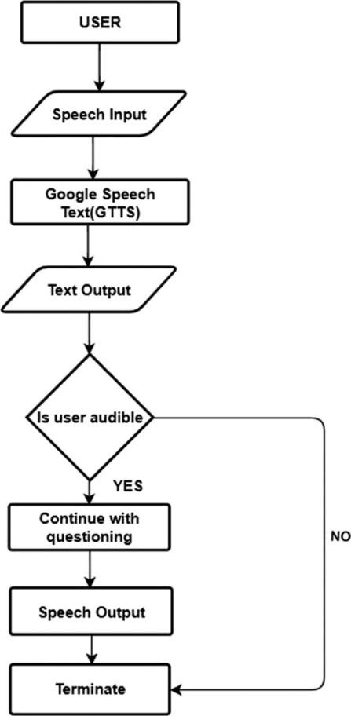
System Design
The campus mapping system called Kareekha is designed to provide efficient and inclusive navigation in our college. The system combines voice recognition and image display technology to provide a real-time, accessible and user-friendly navigation solution. Kareekha responds to voice commands and provides detailed directions to various areas of the campus, including academic blocks, administrative offices, hostels and other important facilities.

Slide 10
The user is responsible for taking and processing voice commands. It uses the Speech
Recognition library for voice recognition.
The system changes the response and direction to audible words. Implements Pyttsx3 for TTS works. Features display accessories, campus map, and navigation section. Using the Python Imaging Library (PIL) for image processing.
Stores campus maps and location data in a structured format. Provide information for precise
navigation.
Interface with the user, handle voice commands and display visual indicators. Show directions and campus map.
Process user commands and create accurate routes. It takes into account the user's current location and destination for step-by-step guidance.

Slide 11
Results

Slide 12
The development of the personalized campus mapping system, "Kareekha," represents a significant step toward enhancing the navigation experience within our college campuses. The main objectives of Kareekha include providing accessible voice-activated navigation, delivering precise directions, and fostering a sense of belonging within our campus community. By incorporating voice recognition, text-to-speech conversion, image display. The commitment to continuous improvement and user-centric design ensures that Kareekha will evolve to meet the evolving needs of our diverse campus population.
As we design and implement this system, we continue to be committed to the principles of efficiency, inclusivity, and accessibility, working to provide a setting where each person is empowered and self-assured in navigating our university campus. The system may be controlled by voice commands, allowing users to do things like ask for directions to particular campus places. To help users get to their intended destinations on the college campus, the system offers step-by-step guidance.

Slide 13
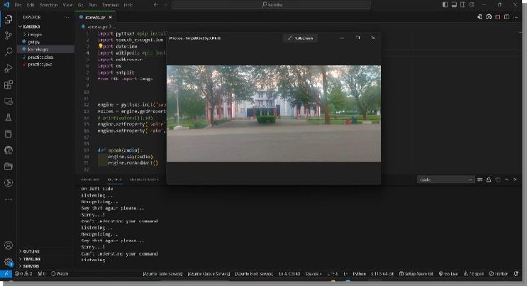
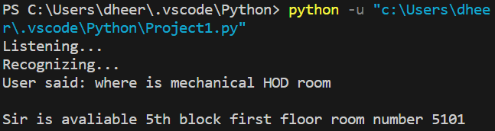
Real Time Demonstration
Popping of Image for the Query
Result for the Query

Slide 14
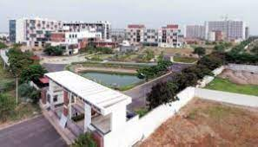
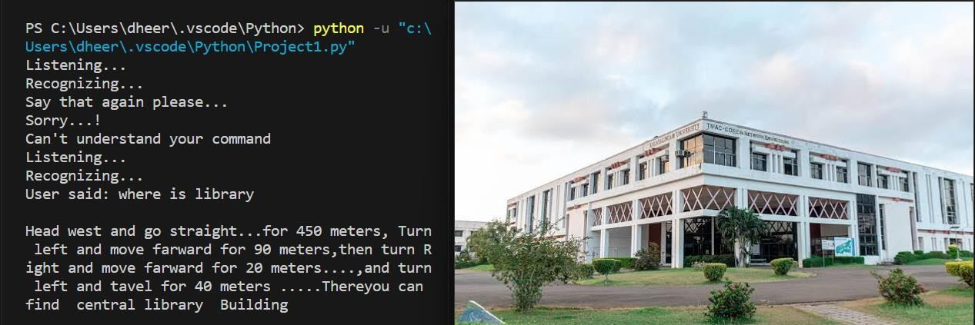
Output in the form of text and Image of the place

Slide 15
References
Knote, R., Janson, A., Eigenbrod, L. and[2] Söllner, M., 2018. The What and How of Smart
Personal Assistants: Principles and Application Domains for IS Research.
Ravivanshikumar ,Sangpal,Tanvee ,Gawand,SahilVaykar, “JARVIS: An interpretation of AIML with integration of gTTS and Python”, [2]proceedings of the 2019 2nd International Conference on Intelligent Computing, Instrumentation and Control Technologies
(ICICICT),Kanpur, 2019.
Aditi Nasikkar, Sakshi Pawar, Yashal Railkar (Object Detection and Recognition System
Using Deep Learning Method, https://doi.org/10.1109/I2CT57861.2023.10126316
Edwin Shabu, Tanmay Bore, [2]Rohit Bhatt, Rajat Singh,”A Literature Review on Smart Assistant” International Research Journal of Engineering and Technology (IRJET),
[1]Volume: 08 Issue: 04, April 2021.
Sahu, Ajay and Jha, Ashish and Bhargava, Ritik and Priya, Priyanshu and Kumari, Rupa, Voice Assistant Using Artificial Intelligence (March 10, 2023). [1]Proceedings of the International Conference on Innovative Computing & Communication (ICICC) 2022

Slide 16
Thanks!

